Slide 1

Mathematical modelling for vaccine-preventable diseases
Epidemiology lecture 3
Vaccination and structured populations
Andrew J K Conlan
University of Cambridge
ajkc2@cam.ac.uk
With materials contributed by Ellen Brooks-Pollock and Sophie Ip
Notes:
Introduce who we are

Slide 2
This lecture
Why is vaccination the most efficient control method for infectious disease?
Herd immunity
Effective reproduction number
Critical vaccination threshold for given transmission parameters
How can we use vaccines to eliminate endemic diseases?
How can vaccination have “perverse consequences”?
Why is the structure of populations important for vaccination?

Slide 3
Preventing a single epidemic
When does an epidemic end?

Slide 4

Preventing a single epidemic
What if the proportion of susceptible individuals was always less than 1/R₀?
Notes:
Need to change these slides

Slide 5
Simple example:
What happens? Nothing!
Notes:
In a model without birth/death

Slide 6
The Basic Reproductive Ratio
Definition: Average number of people an infected person infects at the start of an epidemic.
R₀ = 2
Notes:
All are susceptible

Slide 7
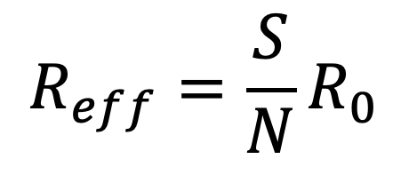
The effective reproductive number
Late in epidemic: number of secondary cases per infectious individual declines
$$R_{eff}={\frac{S}{N}R}_{0}$$
Fraction of contacts that are susceptible
effective
contact rate
Average infectious period
Notes:
Check where the N is

Slide 8
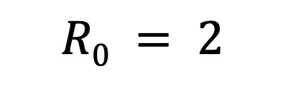
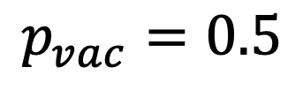
Herd Immunity
$$R0 = 2$$
$$p_{vac}=0.5$$
Population is protected from epidemic spread by herd immunity
Notes:
Purple – encountering individuals which are already immune
So Reff is already less than R0

Slide 9
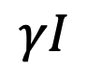
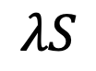
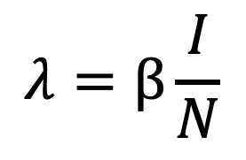
Modelling vaccination
S
$$λS$$
I
$$γI$$
R
Vaccinating a susceptible population
Instead of starting with S = N:
Let R = pN and S=(1-p)N
p is proportion vaccinated
$$λ=β\frac{I}{N}$$

Slide 10
No epidemic
Notes:
Check where the N is

Slide 11
Critical vaccination threshold
Disease will not cause an epidemic!
Notes:
Sub top expression into expression for R_eff

Slide 12
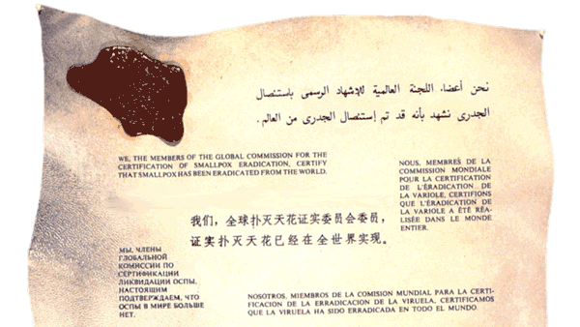
Elimination of endemic disease by vaccination

Slide 13
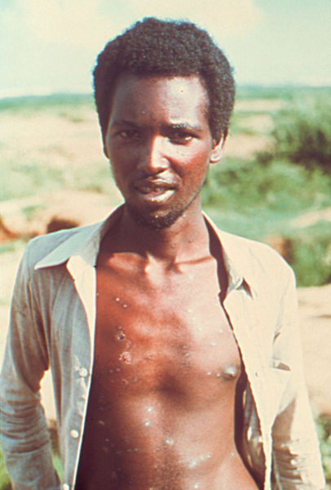
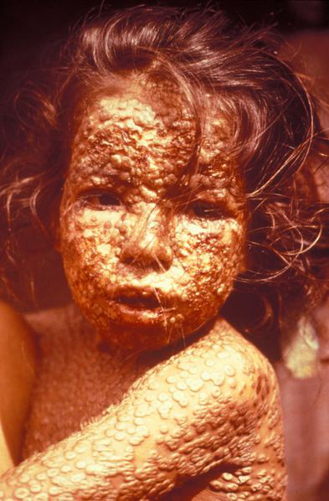
Eradication of smallpox
No animal reservoirs
High levels of morbidity and mortality
Infection results in life long immunity
Effective vaccine
Declared to be eradicated 1979
R₀ = 5-10

Slide 14
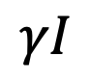
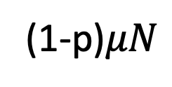
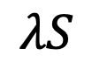
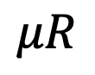
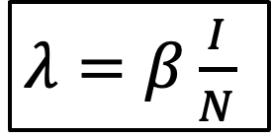
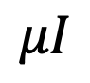
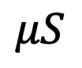
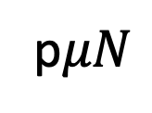
Vaccinating at birth
$λ=β\frac{I}{N}$
$λ=β\frac{I}{N}$
Vaccination at birth can be thought of as short circuiting the path to recovery
“Birth rate” directly into recovered compartment for proportion p
If we want to bookkeep number vaccinated – or model different vaccine effects or timing…
p$μN$
S
$$λS$$
I
$$γI$$
R
(1-p)$μN$
$$μS$$
$$μI$$
$$μR$$
Notes:
In the absence of infection births will enter the susceptible class

Slide 15
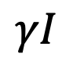
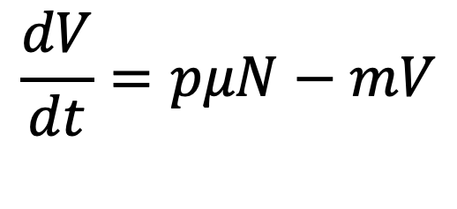
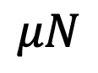
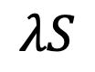
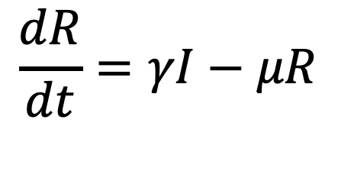
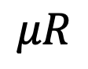
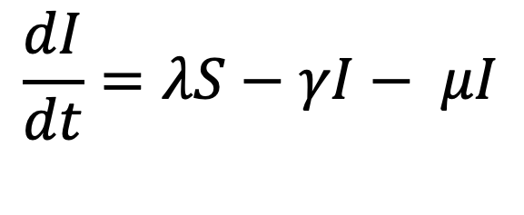
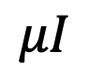
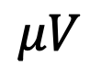
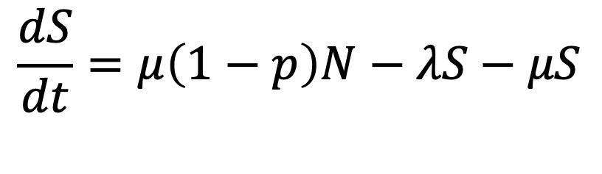
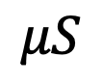
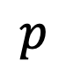
Vaccinating at birth
$$\frac{dS}{dt}=μ\left(1−p\right)N−λS−μS$$
$λ=β\frac{I}{N}$
$$\frac{dI}{dt}=λS−γI− μI$$
(1-p)
S
$$λS$$
I
$$γI$$
R
$$μN$$
$$\frac{dR}{dt}=γI−μR$$
$$p$$
$$μS$$
$$μI$$
$$μR$$
V
$$\frac{dV}{dt}=pμN−mV$$
$$μV$$
Notes:
In the absence of infection births will enter the susceptible class

Slide 16
Steady state
What is the equilibrium number of cases with vaccination?
1
Same as SIR
2
Same as SIR
3
4
Nearly the same as SIR
Notes:
Note there’s a second steady state at I=0 (disease eliminated)

Slide 17
Elimination
Same threshold as in the simple SIR model:
Same vaccination coverage needed to prevent epidemic outbreak, eliminate endemic disease.

Slide 18
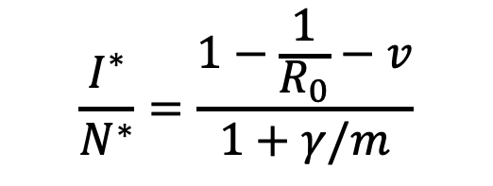
Vaccination reduces number of cases
$$\frac{I^{∗}}{N^{∗}}=\frac{1−\frac{1}{R_{0}}−v}{1+γ/m}$$
Number of cases at equilibrium decreases as vaccine coverage increases
Notes:
This is specifically the peak number of cases

Slide 19
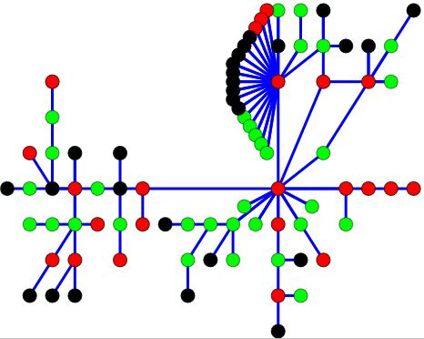

Critical vaccination threshold
Why do we still get flu epidemics every year?
Why have we not eradicated measles?

Slide 20
Age at infection and vaccination

Slide 21
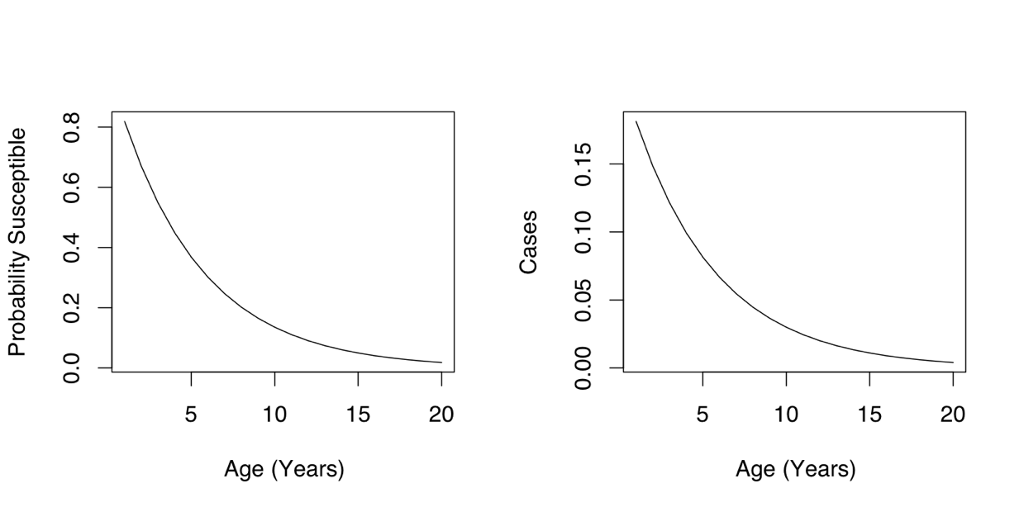
Average age of first infection
Notes:
View first infection age as exponentially distributed? Lambda – force of infection, rate at which susceptible individual is infected, A: average age at first infection
Can use this to infer lambda In a population

Slide 22
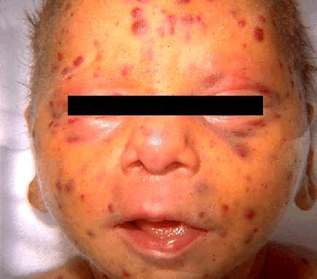
Vaccination increases average age of infection
Number of cases at equilibrium decreases as vaccine coverage increases
Average age of first infection increases as vaccine coverage increases
Congenital Rubella Syndrome
(CRS)
Notes:
Get beta from Reff = beta(1-p)/gamma

Slide 23
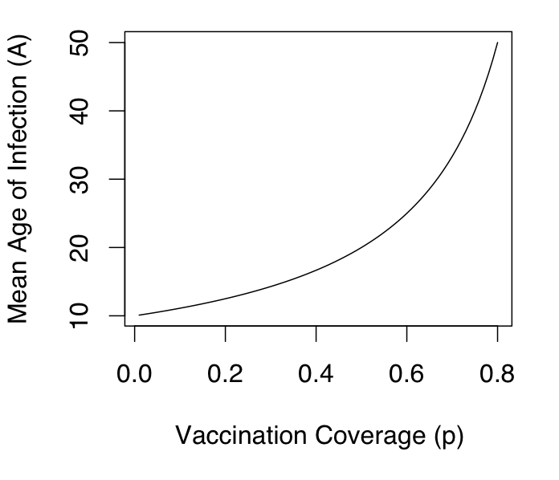
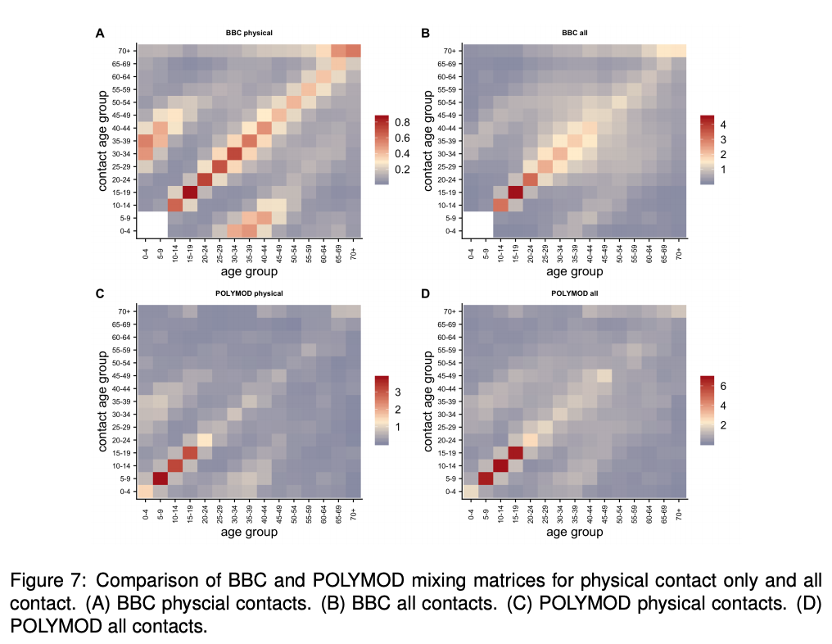
“Perverse consequence” of vaccination
In a well mixed population vaccination coverage of 60% could actually increase incidence of CRS…
Change in mean-age of infection depends on the contact structure (e.g. POLYMOD, BBC, Comix) within the population and which ages targeted for vaccination…
Notes:
Which is an issue because then more pregnant women might get it?

Slide 24

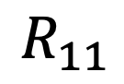
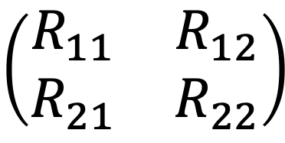
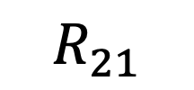
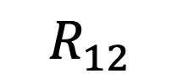
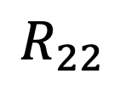
Extending the concept of R₀ to groups
$$R_{22}$$
Next Generation Matrix (NGM)
$$R_{11}$$
$$R_{12}$$
$$\left(\begin{matrix}R_{11} & R_{12} \\ R_{21} & R_{22}\end{matrix}\right)$$
R₀ for the population is the maximum eigenvalue of the next generation matrix
$$R_{21}$$
1
2
Diekmann et al. (2009) Interface doi:10.1098/rsif.2009.0386
Eigenvalues: https://www.youtube.com/watch?v=PFDu9oVAE-g

Slide 25
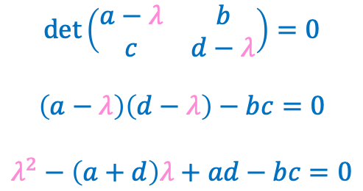
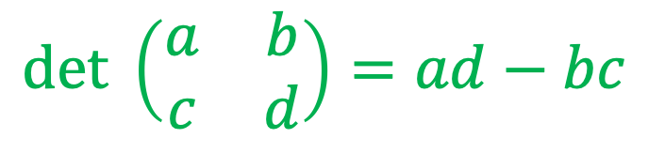
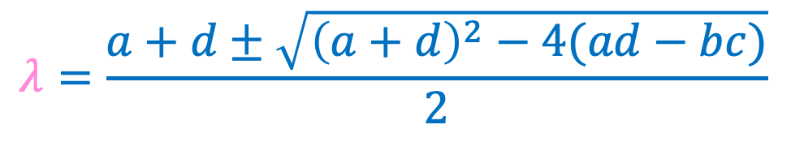
Matrix determinants and eigenvalues
Determinant: single number associated with matrix with many uses (scaling, inverting matrix, solving equations)
Eigenvalues: set of numbers also summarizing matrix properties
$$det \left(\begin{matrix}a & b \\ c & d\end{matrix}\right)=ad−bc$$
$$det\left(\begin{matrix}a−λ & b \\ c & d−λ\end{matrix}\right)=0$$ $$\left(a−λ\right)\left(d−λ\right)−bc=0$$ $$λ^{2}−\left(a+d\right)λ+ad−bc=0$$
$$λ=\frac{a+d±\sqrt{{\left(a+d\right)}^{2}−4(ad−bc)}}{2}$$

Slide 26
Vaccination in structured populations
Consider a population with two age groups:
Where should you target control measures?
Notes:
Assume groups correspond to adults and children. Why is the overall R0 higher than any individual NGM entries?

Slide 27
Vaccination in heterogeneous populations
If we vaccinate at random,
But can we make better use of resources?
Notes:
V = total number vaccinated
V_c, v_a = proportion vaccinated in groups a and c (adults and children)

Slide 28
Next Generation Matrix with vaccination
$$R_{eff}=\frac{3.25−2v_{c}−1.25v_{a}+\sqrt{{\left(3.25−2v_{c}−1.25v_{a}\right)}^{2}−9.5\left(1−v_{c}\right)\left(1−v_{a}\right)}}{2}$$
To control transmission, put $R_{eff}$= 1 and rearrange:

Slide 29
Notes:
How do we calculate V? Assume half and half populations

Slide 30
Notes:
Line on plot corresponds to 53% of both pops

Slide 31
Optimal to vaccinate a higher % of children to reduce transmission
Notes:
i.e. same result as a random vaccination programme. Assuming half and half populations

Slide 32
Notes:
Second condition corresponds to not having transmission within first group

Slide 33
Summary
Herd immunity reframes the problem of disease control from protecting individuals to preventing transmission
Above a critical vaccination threshold population is protected from epidemics
The same value defines the threshold for elimination of endemic disease from a population
The reduction in transmission from vaccination increases average age of infection, which may lead to perverse consequences
Vaccination policy can exploit heterogeneous populations by targeting core groups that drive transmission

